Slide 2
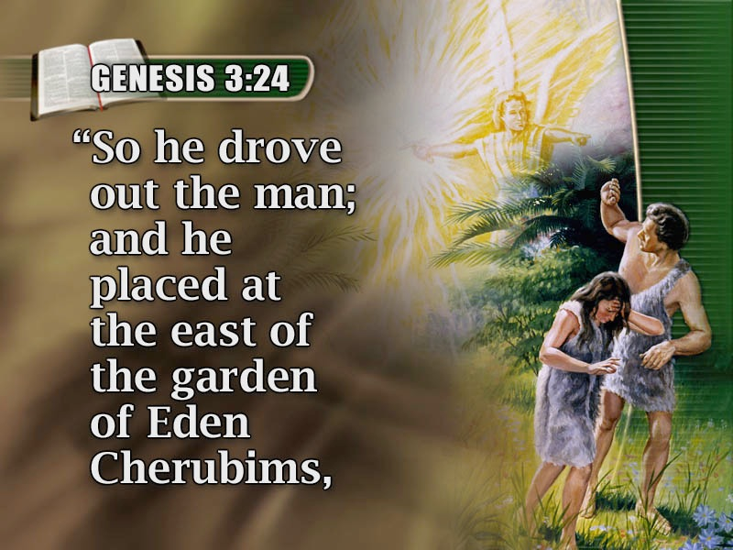
God “Drove out the man…”
Genesis 3:24

Slide 3
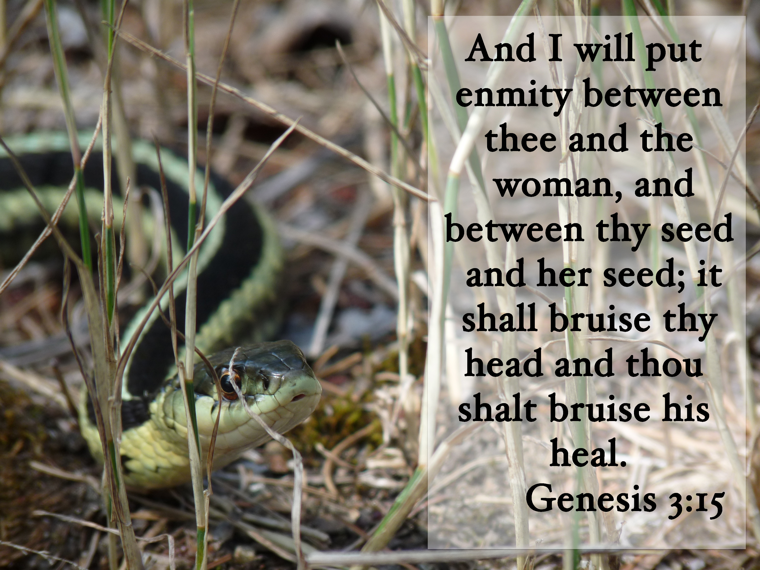

Slide 4

Ephesians 6:12

Slide 5
SACRIFICES
TYPES and ANTI-TYPES

Slide 6

INSTITUTION OF THE SACRIFICE
Genesis 4:3,4 “The Lord respected Abel and his offering.”
Hebrews 11:4 “By faith Abel offered to God a more excellent sacrifice…”
Romans 10:17 “faith comes by hearing, and hearing by the word of God”
2 Corinthians 5:7 “we walk by faith, not by sight.”
Genesis 7:2 “You shall take with you seven of every clean animal…”

Slide 7
DESIGN OF SACRIFICES AND OTHER TYPES
TYPE- 1. A strike of a blow; 2. The impression or print produced by a blow.
John 20:25 “Unless I see in His hands the PRINT of the nails, and put my finger into the PRINT…”
TYPE- Denotes a model set before us for our imitation. Philippians 3:17; 1 Thessalonians 1:7
TYPE- In printing it means that which make the impress or mark.

Slide 8
DESIGN OF SACRIFICES AND OTHER TYPES
TYPE- In religion, it is simply a shadow of things to come – and usually of good things.
In the O.T. most rites & ceremonies were simply shadows of things to come with Jesus and His church as their substance.
Colossians 2:16,17 “which are a shadow of things to come, but the substance is of Christ”
Hebrews 10:1 “law…a shadow” “not…image”
1 Corinthians 10:6,11 “examples…our admonition”

Slide 9
MOSES RESEMBLED CHRIST AS A DELIVERER AND A MEDIATOR
Deuteronomy 18:15 “a prophet like me from your midst”
Deuteronomy 18:18,19 “'I will raise up for them a Prophet like you from among their brethren” “He shall speak to them all that I command Him.”
Acts 3:22,23 “Moses truly said to the fathers, 'The LORD your God will raise up for you a Prophet like me from your brethren” “Him you shall hear in all things”

Slide 10
CANAAN A TYPE OF HEAVEN
Hebrews 4:9-11 “There remains therefore a rest for the people of God. 10 For he who has entered His rest has himself also ceased from his works as God did from His. 11 Let us therefore be diligent to enter that rest, lest anyone fall according to the same example of disobedience.”
ADAM A TYPE OF CHRIST
Romans 5:12-14 “Adam…a type of Him…to come”
1 Corinthians 15:22,45 “first man Adam…living being” “last Adam…life-giving spirit.”

Slide 11
PASCAL LAMB
1 Peter 1:18-20 “the precious blood of Christ, as of a lamb without blemish and without spot”
John 19:36 “Not one of His bones shall be broken”
1 Corinthians 5:7 “Christ, our Passover, was sacrificed for us.”

Slide 12
DESIGN OF ALL TYPES IS TWOFOLD
1. To give a pictorial and outline representation of something in the future
Especially of the Scheme of Redemption
Primary object of all sacrifices offered during both Patriarchal and Jewish age
Hebrews 9:1-10:18 “copies of the things in the heavens should be purified with these, but the heavenly things themselves with better sacrfices that these.”

Slide 13
DESIGN OF ALL TYPES IS TWOFOLD
2. A Proof and Demonstration of the Divine Origin of the Anti-type
Hebrews 3:5 “a testimony of those things which would be spoken afterward”
1 Peter 3:18-22 “also an antitype which now saves us.”
The Water which covered the Earth is likened to the Waters of Baptism – Acts 22:16

